Slide 1

AFNT Project Ali Suhail | 21072712

Slide 2
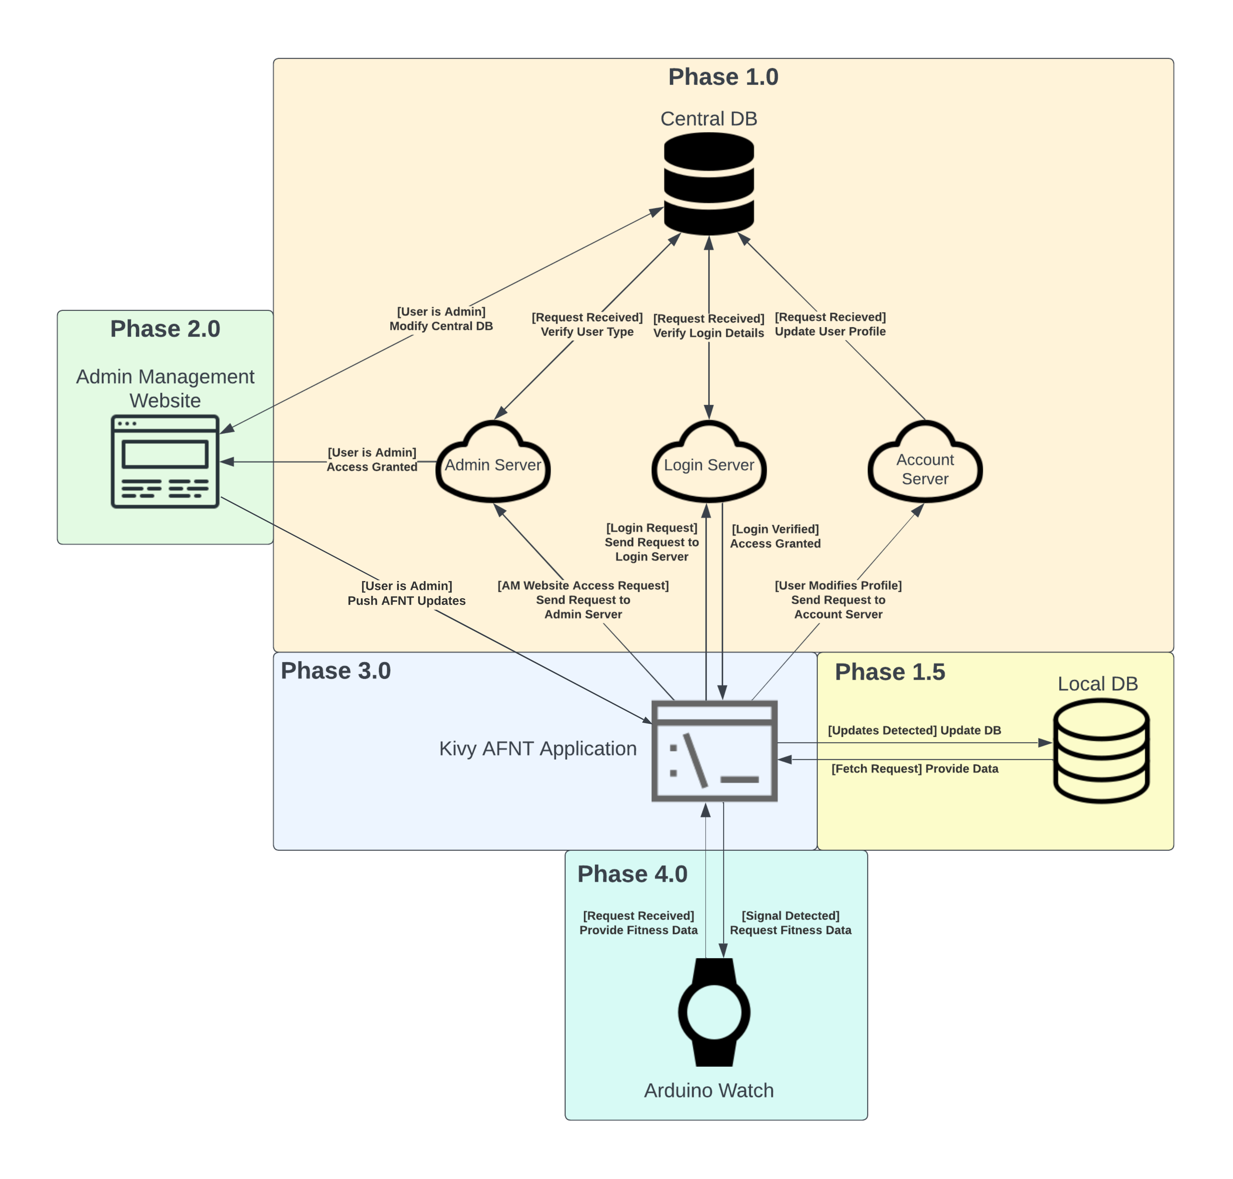
Agenda
Phase 1: DBMS
Phase 2: AW Website
Phase 3: AFNT Application
Phase 4: Arduino Watch

Slide 3
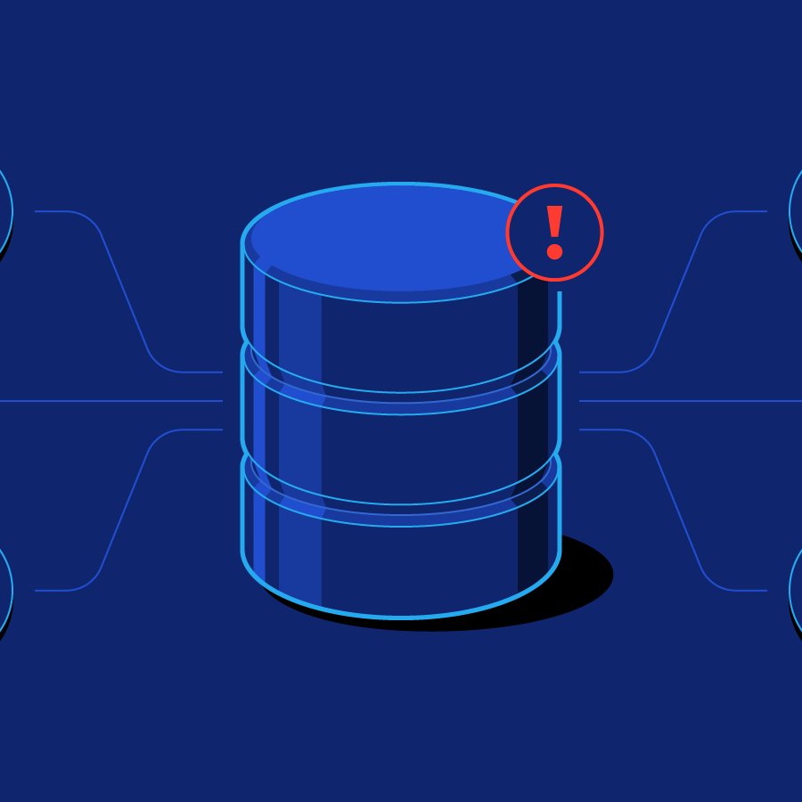
Phase 1: DBMs

Slide 4

Central database (cdb)
Managed by Admins and responsible for managing:
Preset workouts and exercises.
Preset meals and food items.
User details.
CentralDB updates to AFNT App.

Slide 5
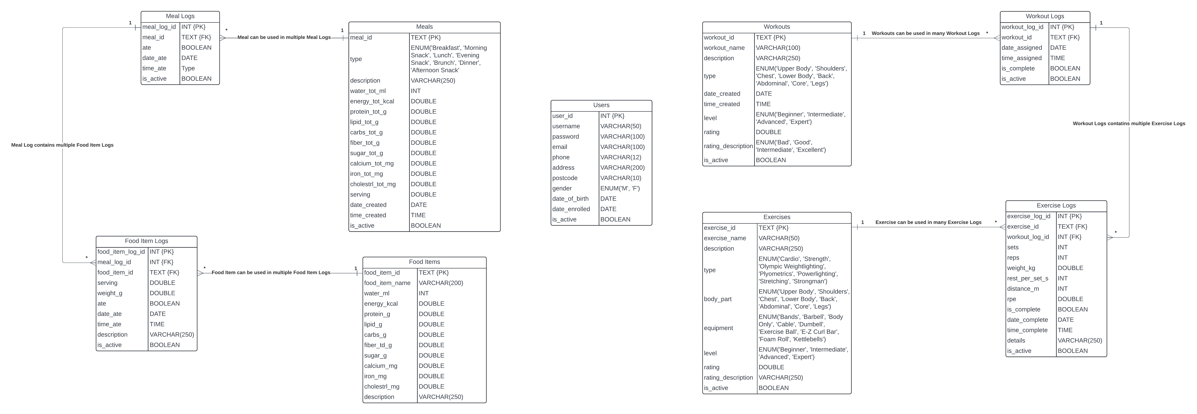
Central database schema

Slide 6

Local database (ldb)
Managed by AFNT users and responsible for managing:
Custom workouts and exercises.
Custom meals and food items.
Use preset workouts and meals.
Log body data (steps, weight, etc).
User details.

Slide 7
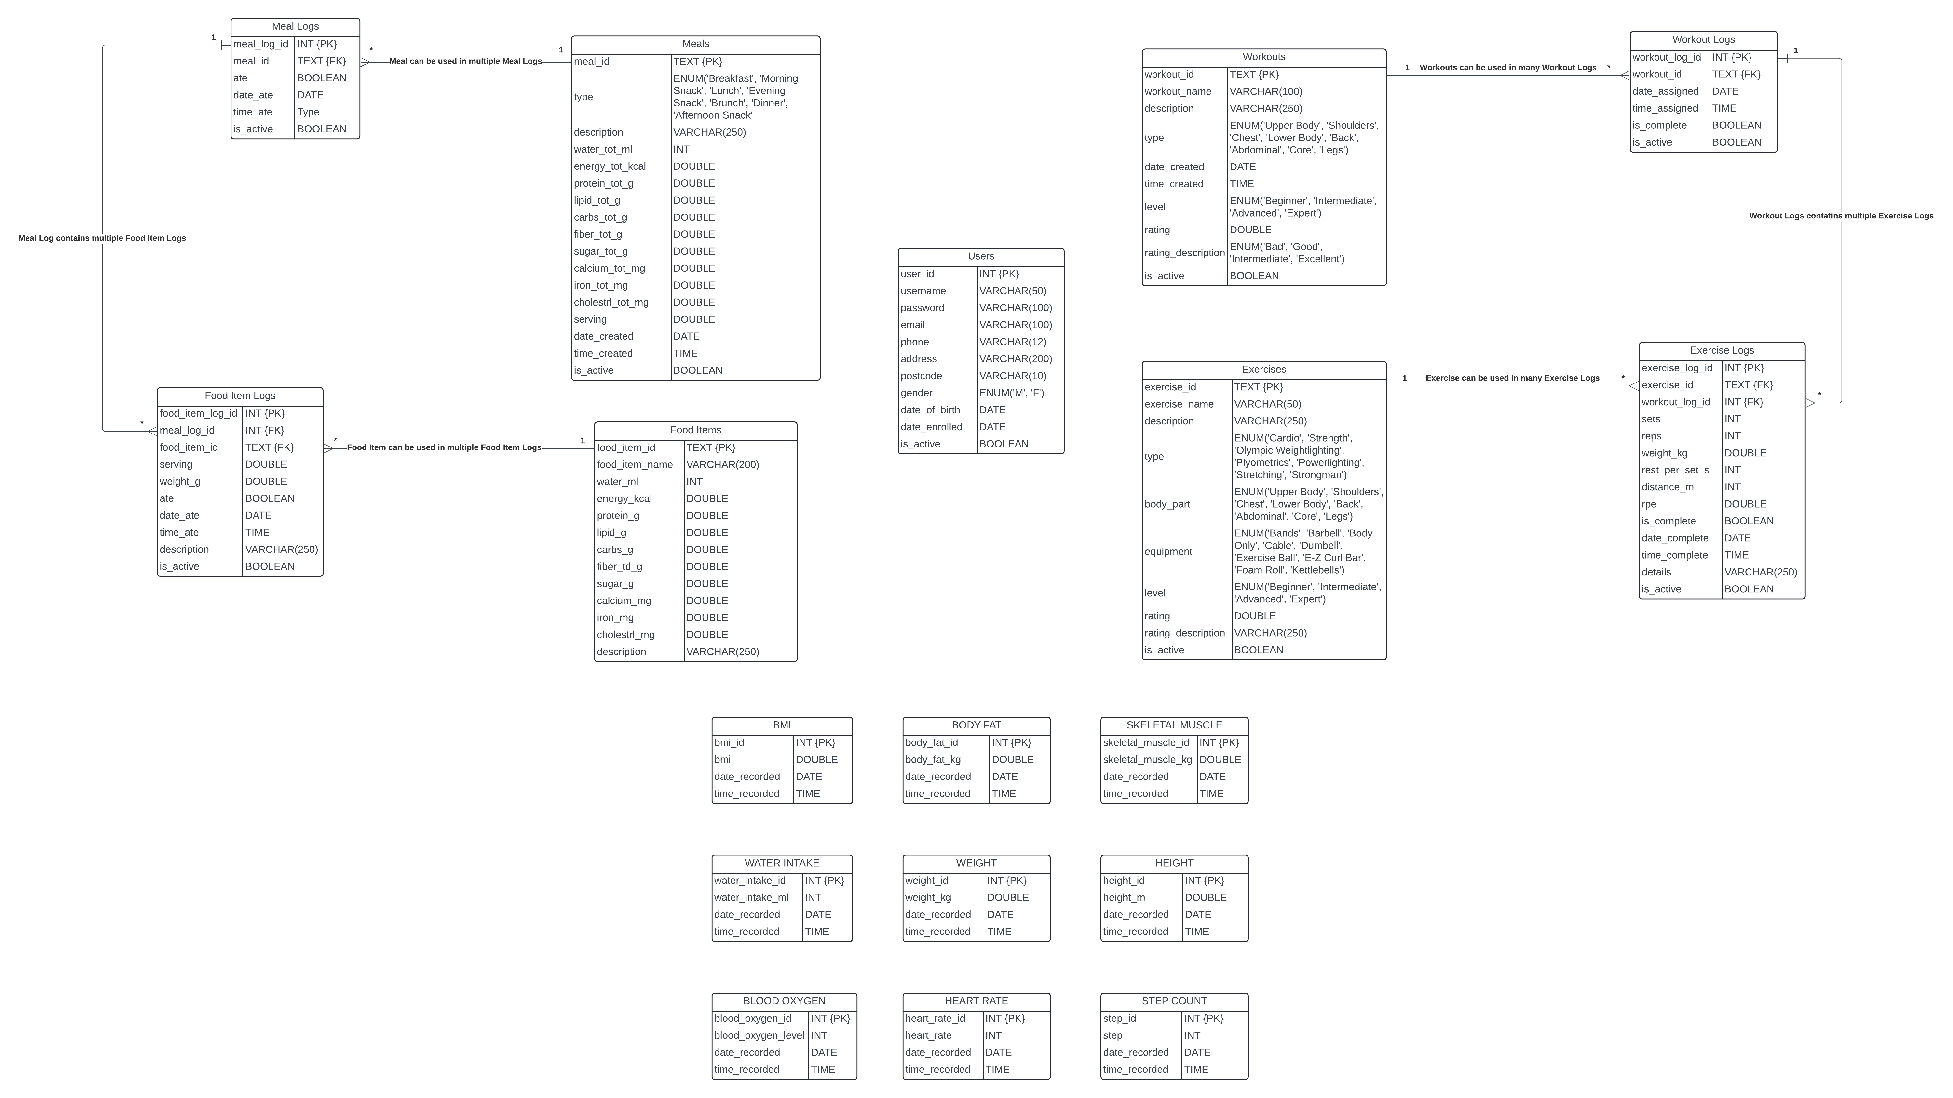
Local database schema

Slide 8

Phase 2: am website

Slide 9
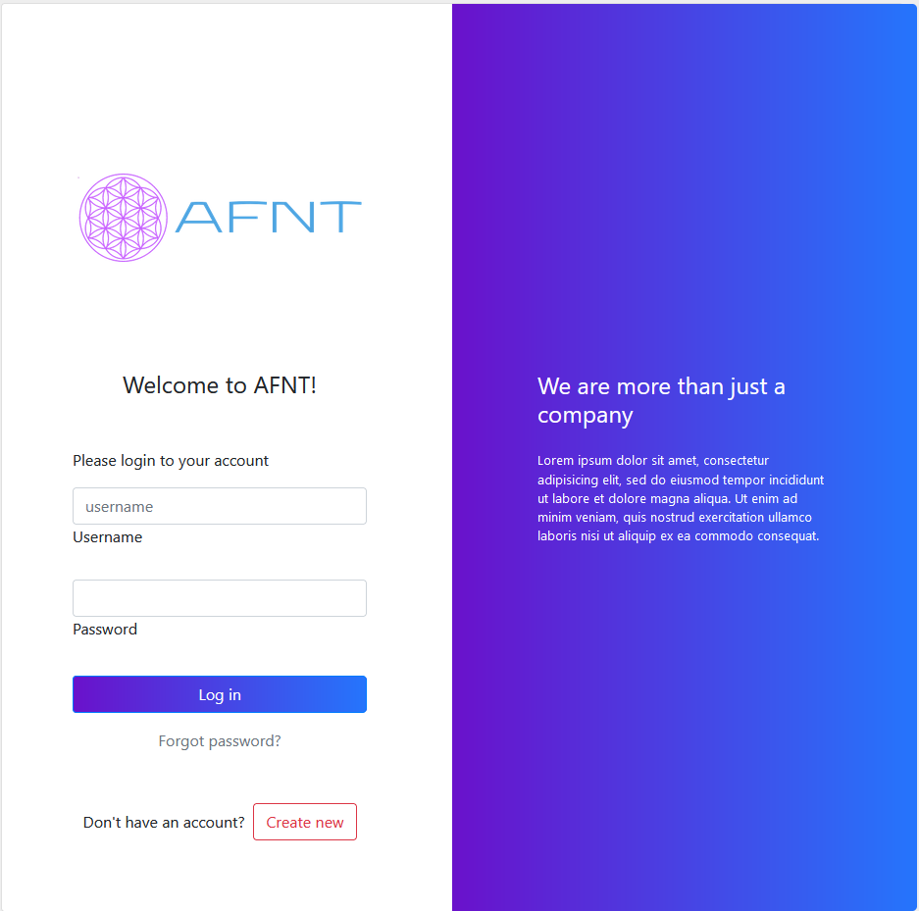
Admin management website (aw website)
Website for Admins and manages:
Preset workouts and exercises.
Preset meals and food items.
User details.
CentralDB updates to AFNT App.

Slide 10

Phase 3: AFNT App

Slide 11
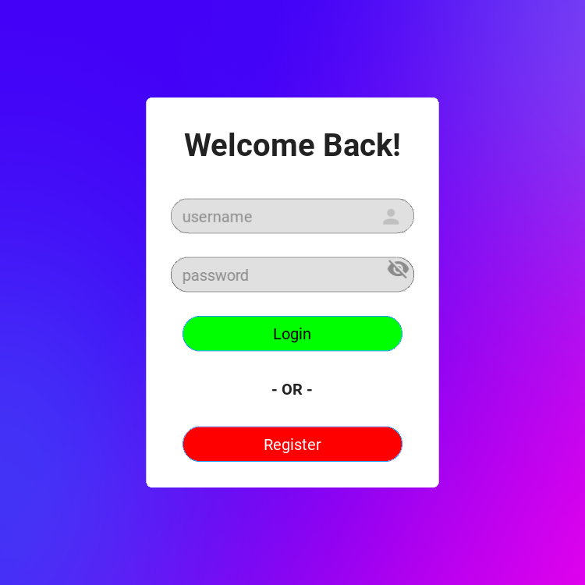
Afnt application
Cross-platform app for users, and allows users to:
Manage workouts and exercises.
Manage meals and food items.
Locate closest gyms/fitness centres.
Log body data.
Log meal and water intake data.
Generate plots for body and meal data.
Link with the Arduino Watch (Phase 4).

Slide 12
Phase 4: Arduino Watch

Slide 13
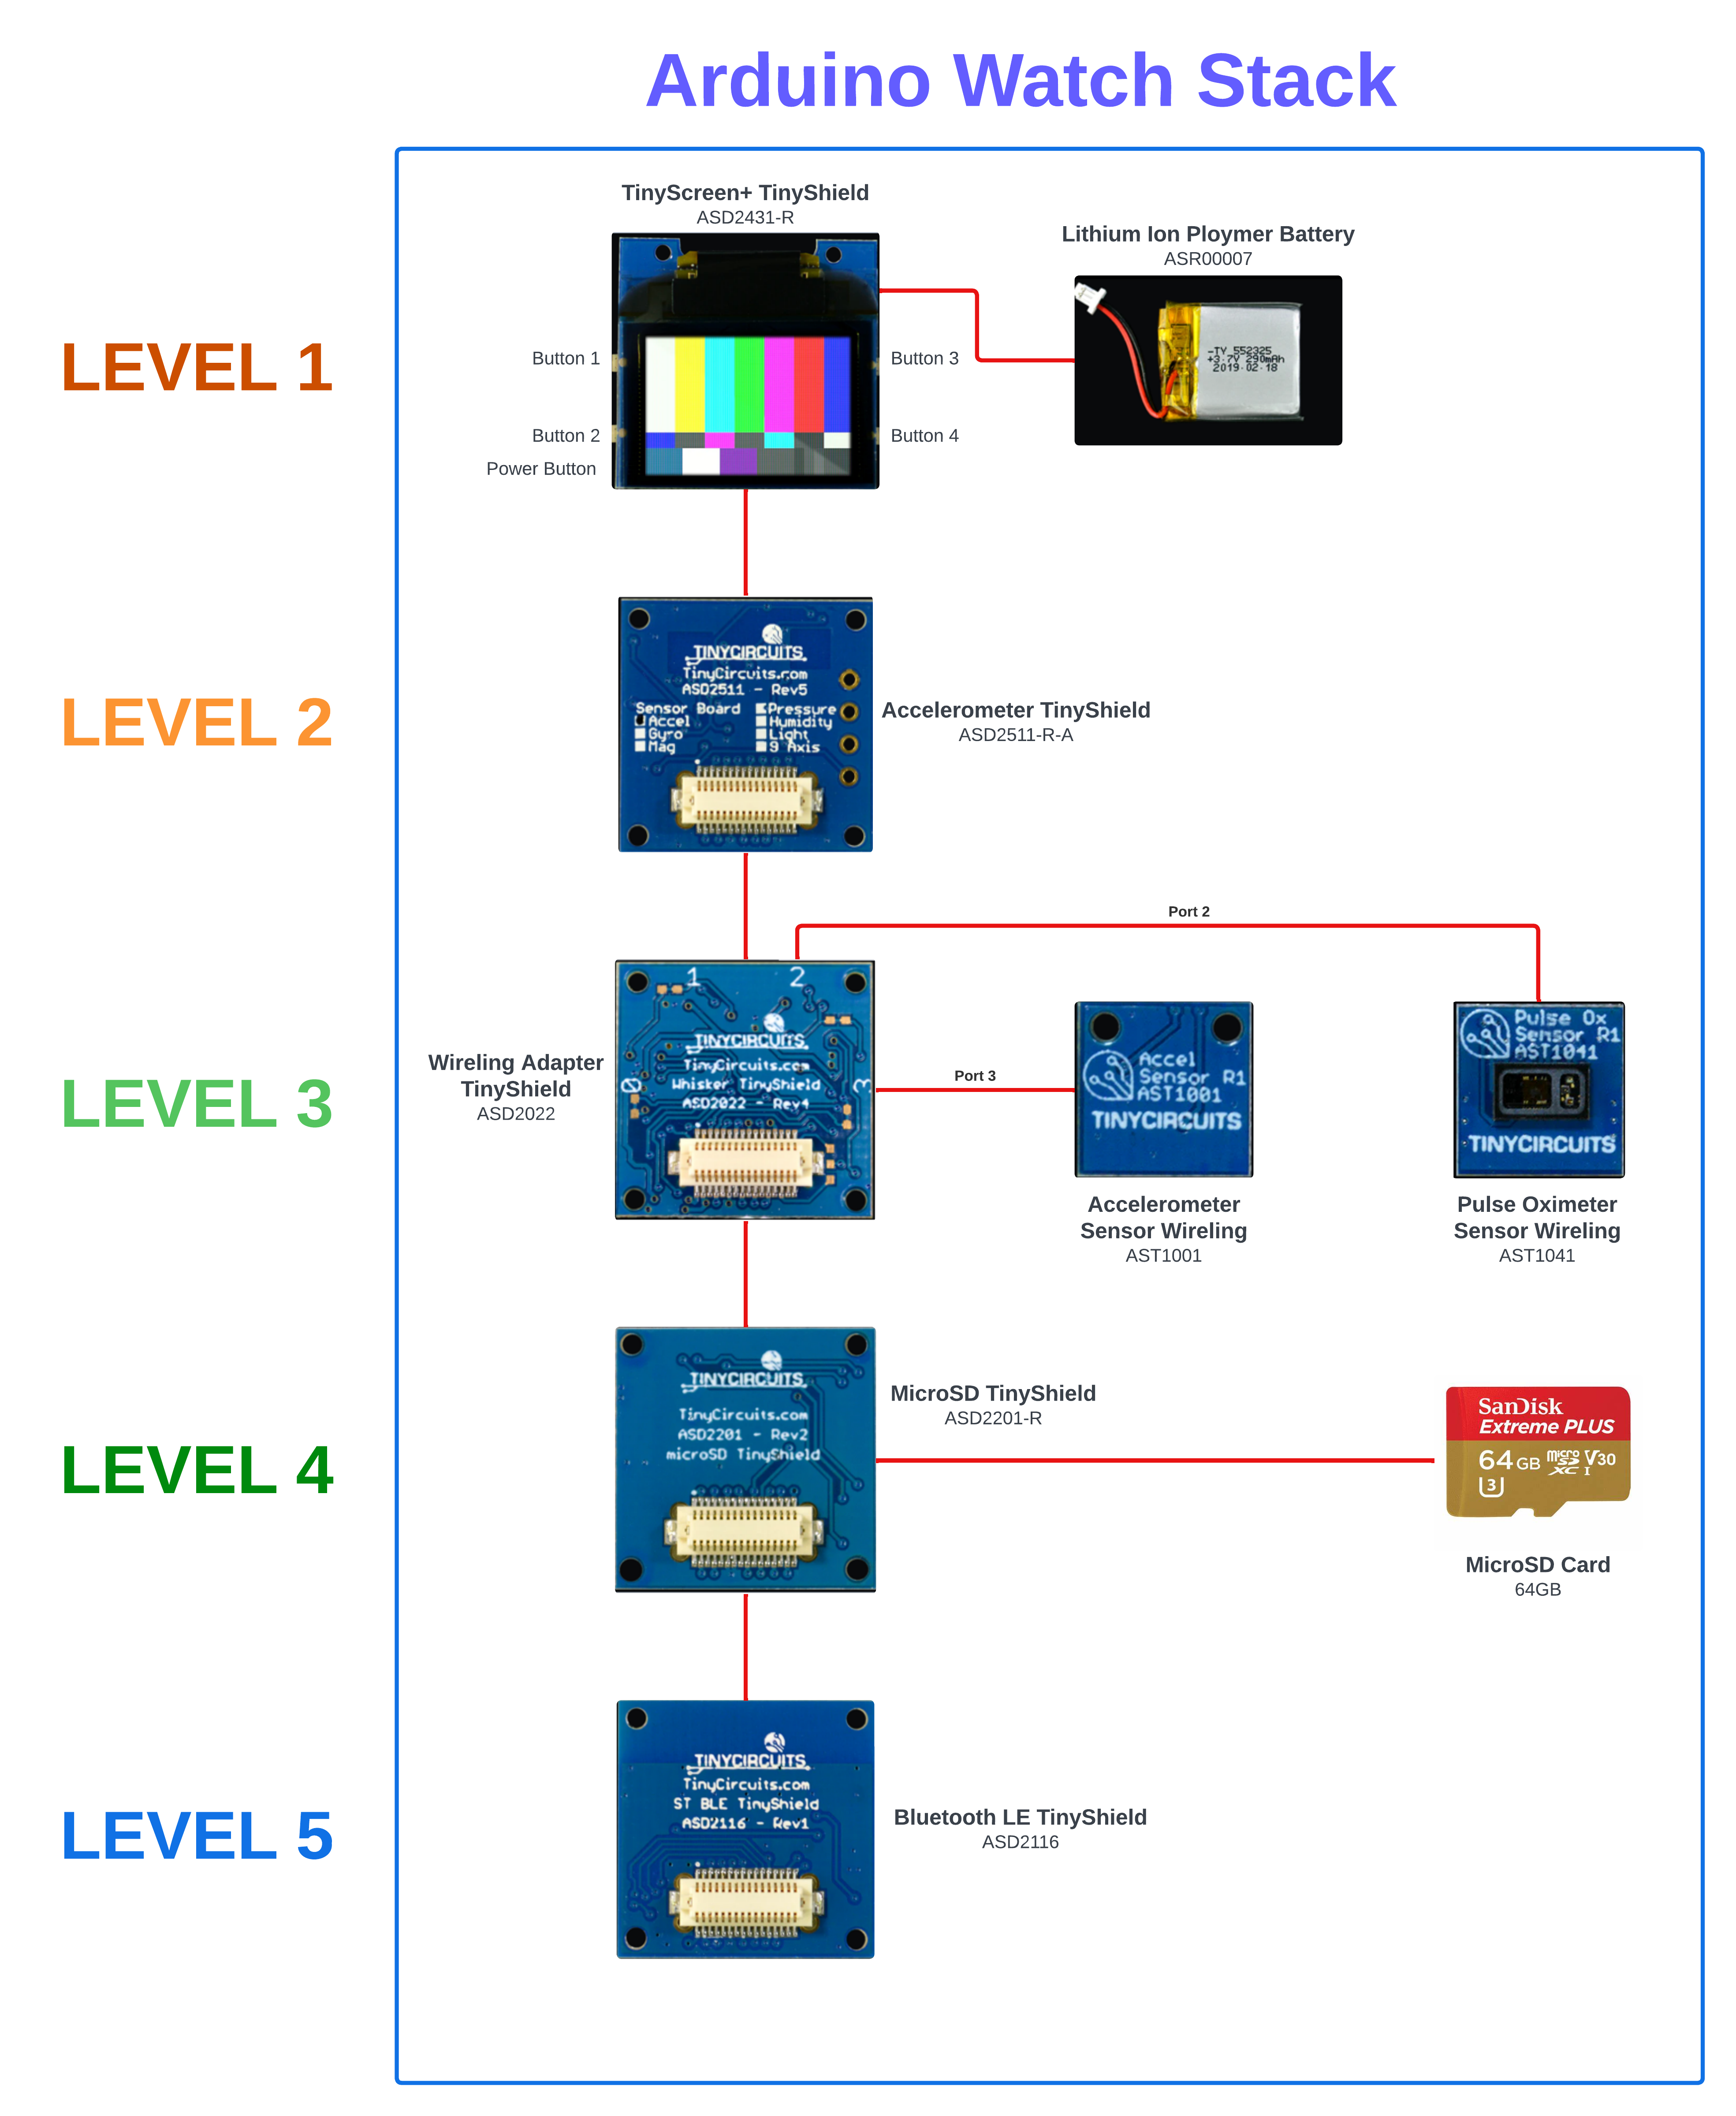
ARDUINO WATCH
Uses TinyCircuit’s small modular components and allows users to:
Track steps and step goals.
Heart rate.
Blood oxygen level (saturation level).
Body temperature.
Logs data into CSV file.
Accessed by AFNT app via USB or Bluetooth Low Energy (BLE).

Slide 14
Current progress

Slide 15
Afnt project progress
Phase | Percentage Complete | Not Implementing | Not Started | Partially Complete | Complete
Phase 1 | 86% | 0 | 0 | 5 | 13
Phase 2 | 30% | 8 | 1 | 5 | 3
Phase 3 | 61% | 2 | 8 | 21 | 35
Phase 4 | 73% | 0 | 0 | 8 | 7

Slide 16

Thank you

